Slide 1
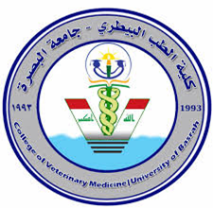
poultry diseases fourth stage
Prevention and Control of poultry diseases
By
Dr. Isam Azeez
Department of Pathology and Poultry Disease
College of Veterinary Medicine university of Basrah

Slide 2
How diseases occur in poultry :
The main components that need to interact with each other for an infectious disease to occur
1- the causative agent: bacteria, viruses, Parasites or fungi.
2- the host who is the target of the disease.
3- the environment.
4- Vector.

Slide 4
* How infectious diseases are transmitted
* control their spread
Transmission pathways can be:
Vertical transmission: from the hence to chicks
Horizontal transmission
1- direct transmission: Bird to bird contact
2- indirect transmission: through contaminated equipment, Mechanical transmissions such as a mosquito or a tick

Slide 5
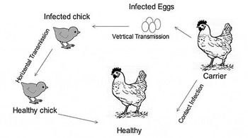

Slide 6
How can we prevent and control poultry diseases?
1- Reduce exposure to disease organisms by proper sanitation and good management.
2- Immunization is critical in increasing bird resistance to disease, making it a vital strategy in disease control.
3- Medications against the disease when disease outbreaks occur, necessary action in disease control.

Slide 7
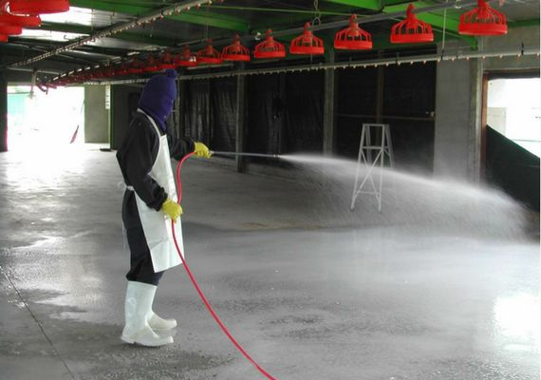
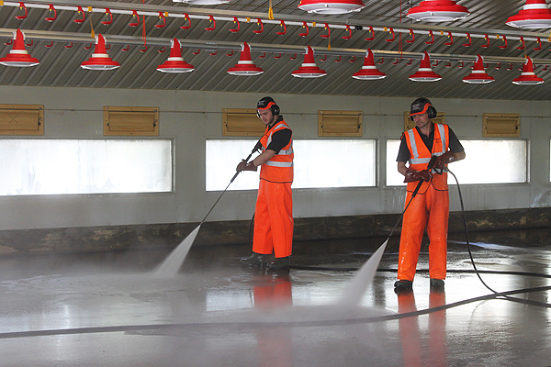
1- Sanitation and Biosecurity :
Effective cleaning and disinfection are essential and should be carried out periodically to reduce the build-up of pathogenic organisms. Attention should be paid to farm equipment entering the farm, the cleanliness of personnel on the farm, the disposal of dead birds and poultry droppings, and the sanitization of the drinking water.

Slide 8
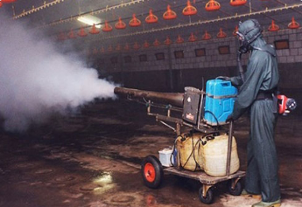
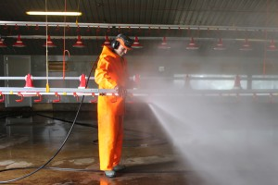
Cleaning and disinfection of poultry houses:
Dry cleaning (i.e., brushing, scraping, etc.) should be performed inside and outside the buildings.
Wet cleaning involves soaking, washing, and rinsing.
Washing: Wash every surface in the building, especially window sills, ceiling trusses, wall sills, and any surfaces where dirt and dust may accumulate.

Slide 9
Fumigation
When using formalin and potassium permanganate for fumigation in poultry farms, it’s essential to follow the recommended application rates and conditions to ensure effectiveness
Recommended Fumigation Protocol
Fumigant Components:
Formalin: 35 ml per cubic meter (m³)
Potassium Permanganate: 17.5 g per cubic meter (m³)

Slide 10
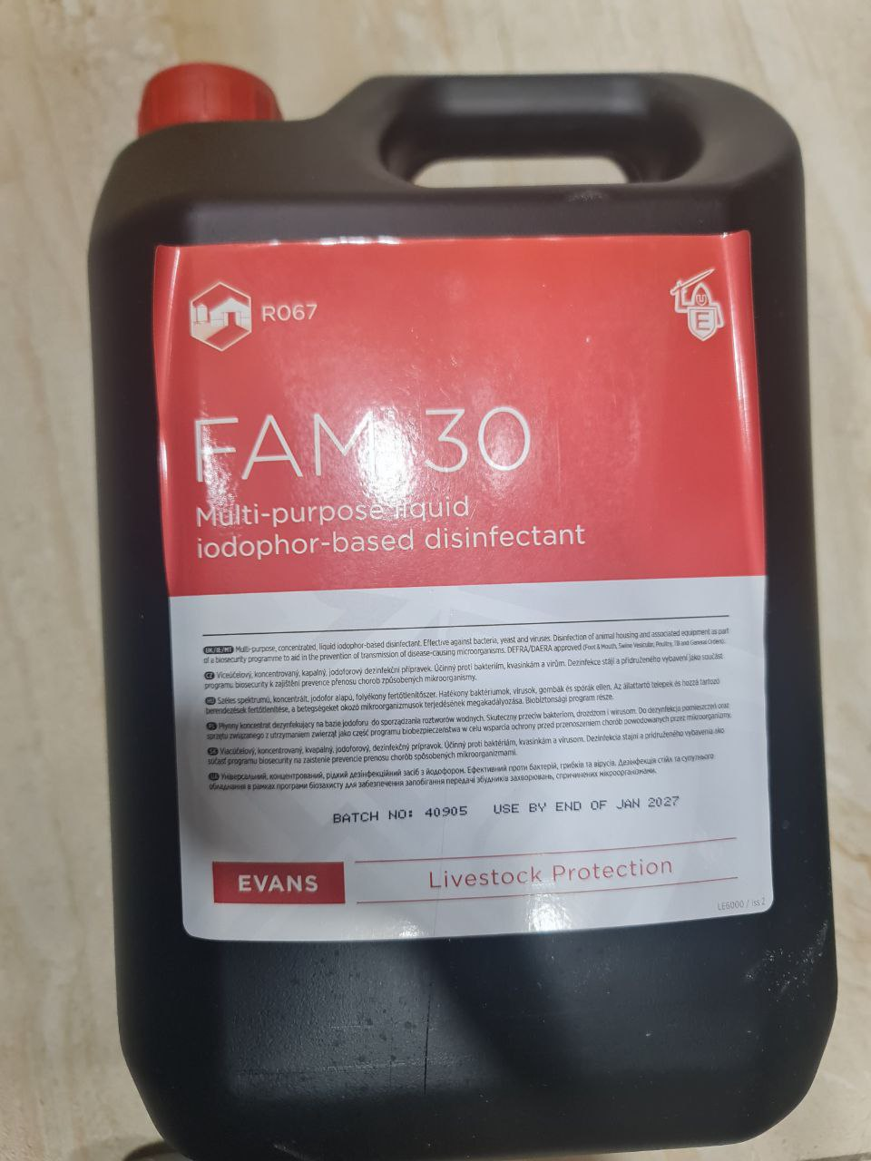
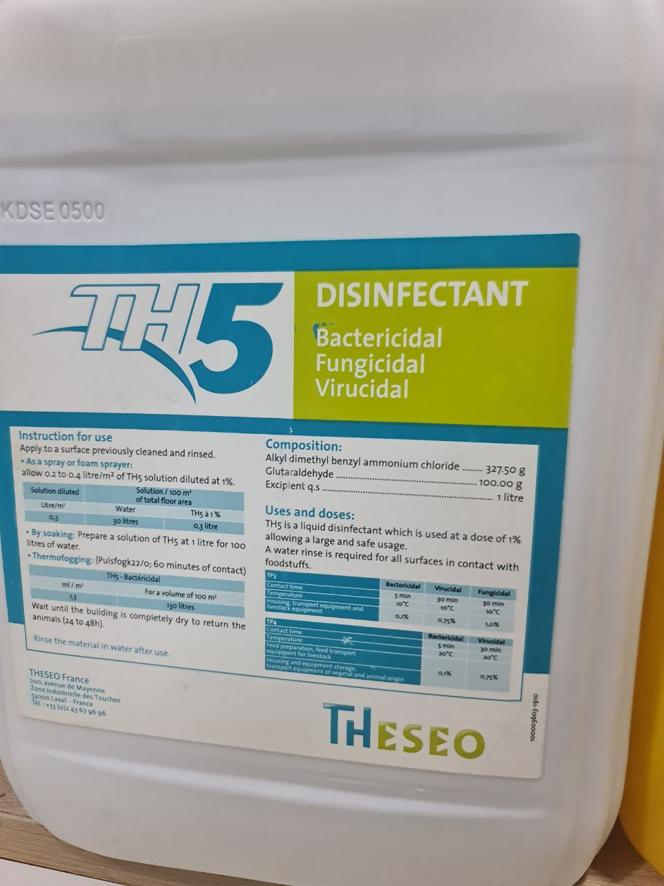
Common Disinfectants

Slide 11
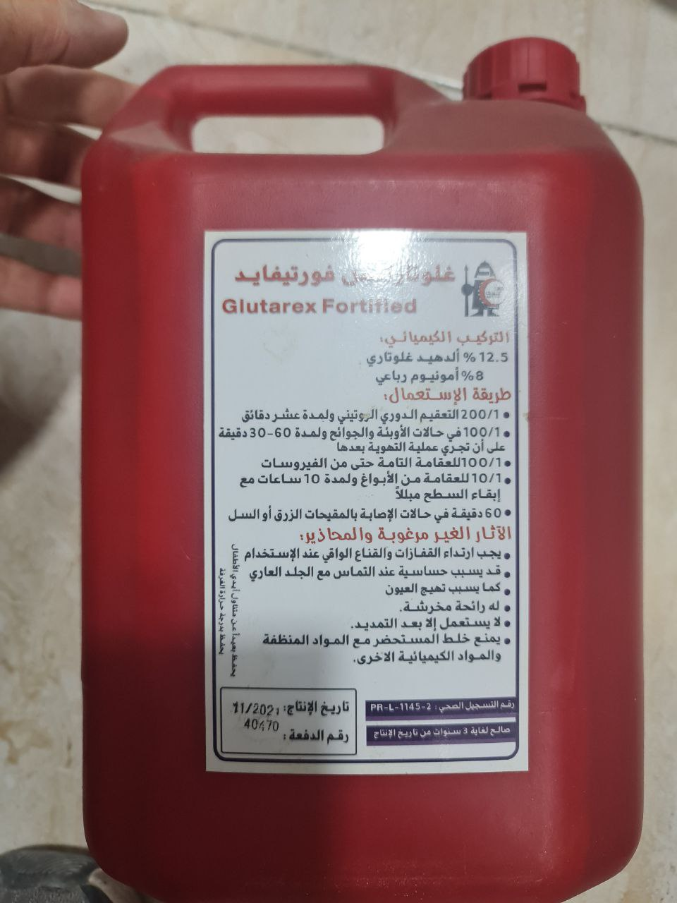
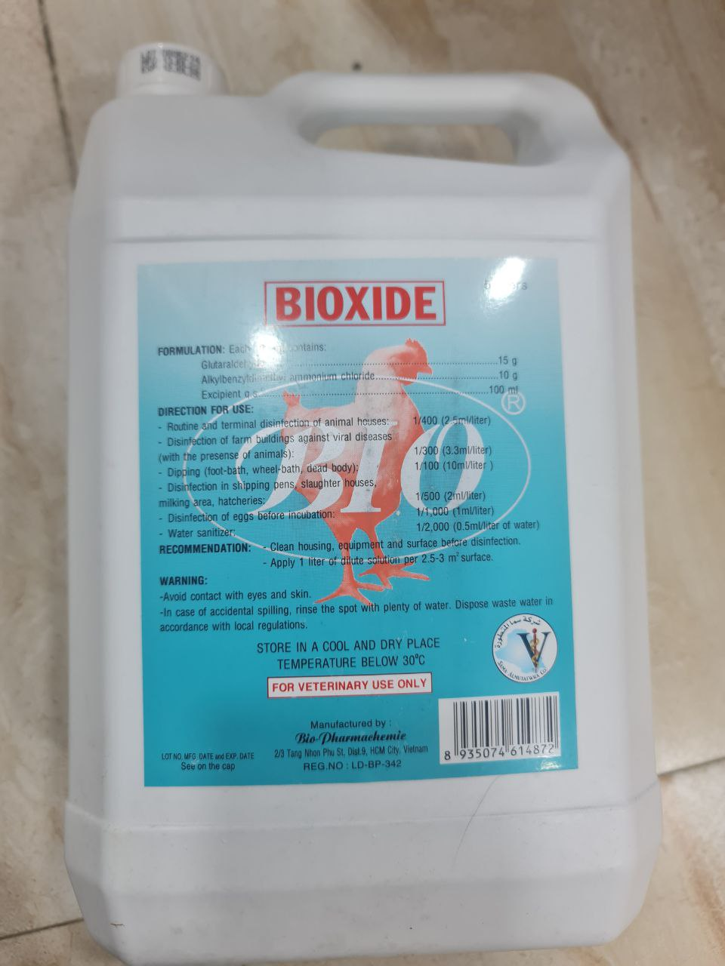

Slide 12
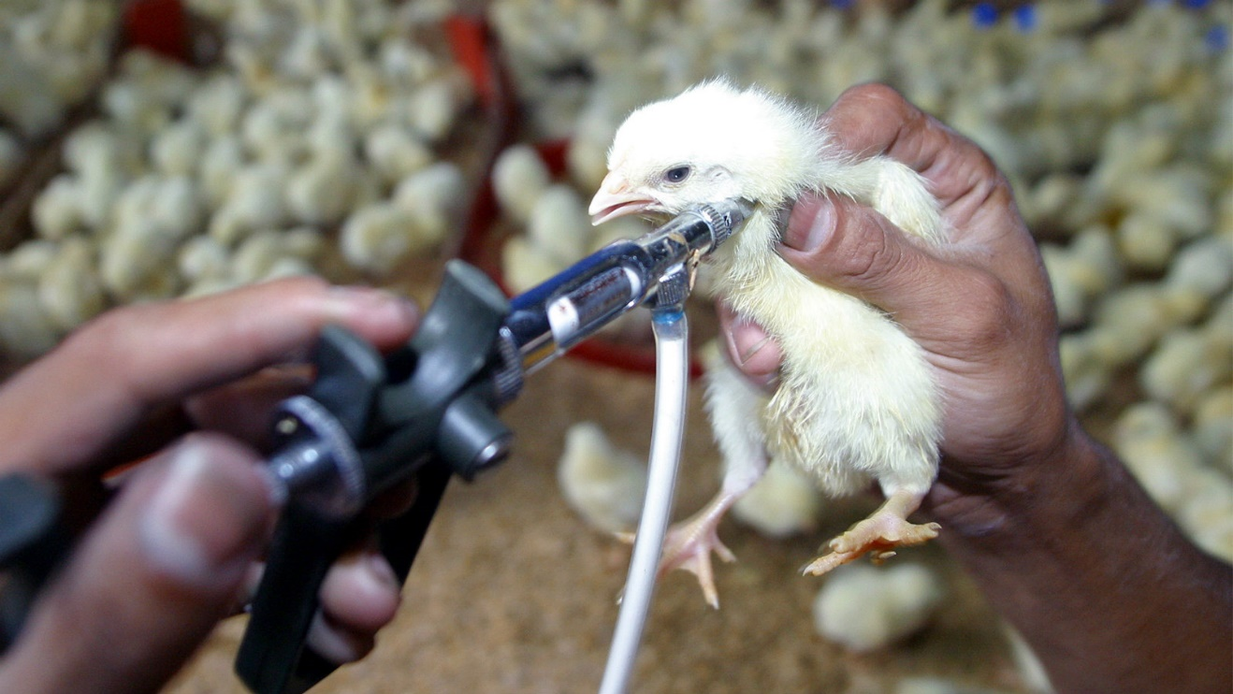
2-vaccination
Poultry vaccines are widely applied to prevent and control contagious poultry diseases.

Slide 13
Types of vaccine
Live vaccine :
the active part of the vaccine is the live organism that causes the disease
Attenuated vaccine
with this type of vaccine the organism has been weakened by special procedures during manufacture so that it has lost its ability to cause the serious form of the disease.
Killed vaccine :
with this vaccine, the organism has been killed and cannot cause the disease, although the ability to trigger the immune system remains.

Slide 14
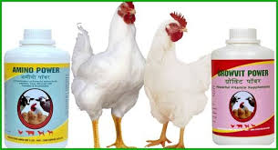
3- medication
Some antibiotics have been used in poultry medicine include the following:
Aminoglycosides (e.g., gentamycin, neomycin, spectinomycin, and streptomycin)
Bambermycins (e.g., bambermycin, flavophospholipol)
Beta-Lactams.
Penicillins (e.g., penicillin and amoxicillin)

